Slide 1
Unit 1: Career Decision-making Agenda
Rogue Community College
Review Myths about Career Decision-Making
Learn the Elements of Career Decision-Making
Explore the Steps in Good Decision-Making
Learn to Prioritize

Slide 2
Myths about Career Decision-Making
Choosing a career is easy
Money is the key to happiness
You will learn to hate your hobby if it becomes your career
Hot “Careers of the Future” should guide my choice
Others know better than I what career would be best for me

Slide 3
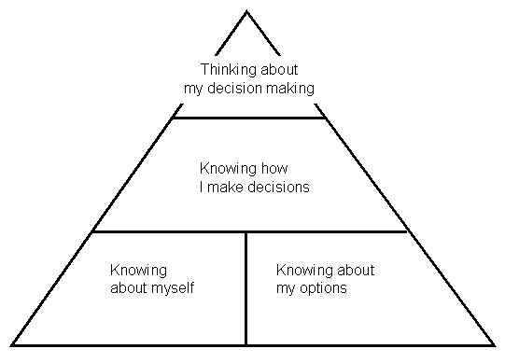
Elements of Career Decision-Making

Slide 4
Organizing Information: John Holland’s Hexagram
Investigative
Artistic
Realistic
Social
Conventional
Enterprising

Slide 5
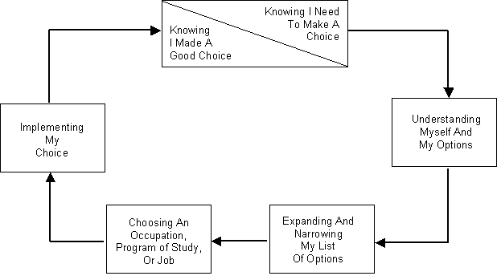
Steps in Making a Good Decision

Slide 6
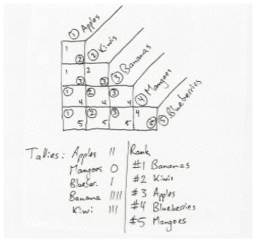
Example-Grid

Slide 7
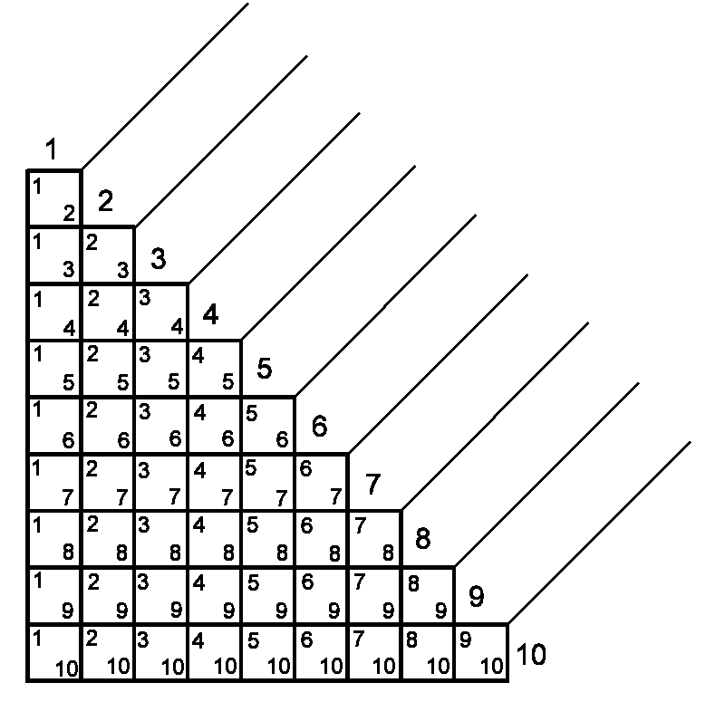
Prioritizing Grid
Priorities
1.
2.
3.
4.
5.
6.
7.
8.
9.
10.

Slide 8
In conclusion, you have:
Reviewed and debunked the myths about career decision-making
Learned the elements of career decision- making
Explored the steps in good decision-making
Learned to prioritize, a valuable life skill!

