Slide 1
Where Can I Find the Information I Need and How Do I Use It?
AGENDA:
Learn and describe the requirements of occupations of interest
Identify items that are important in occupational choice.
Become familiar with a range of career information resources.
Compare and evaluate occupational options.

Slide 2
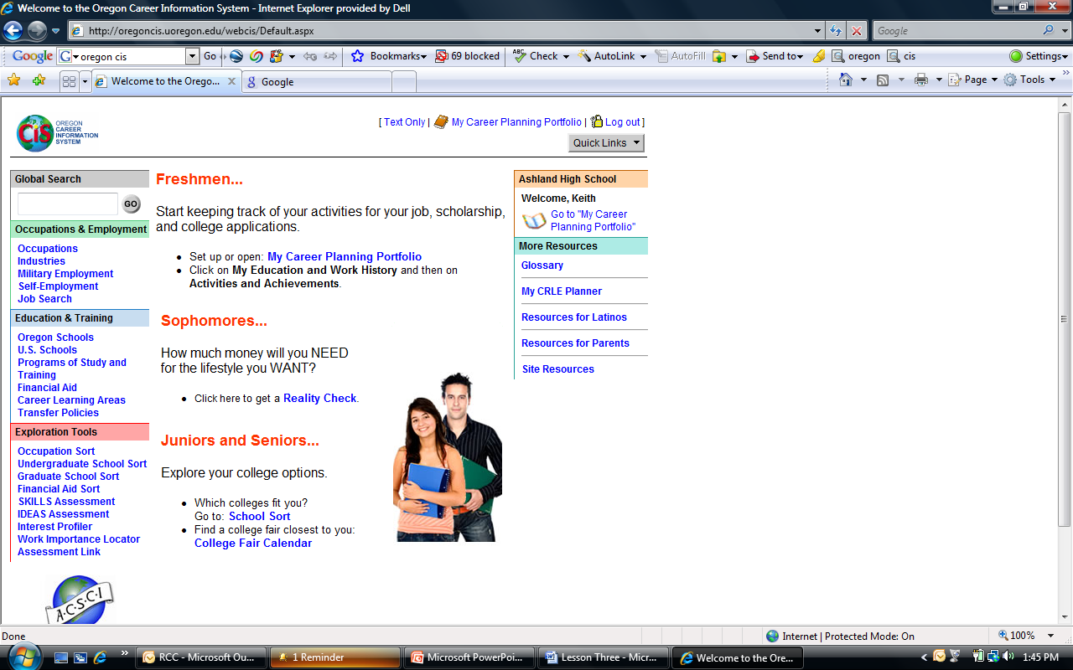
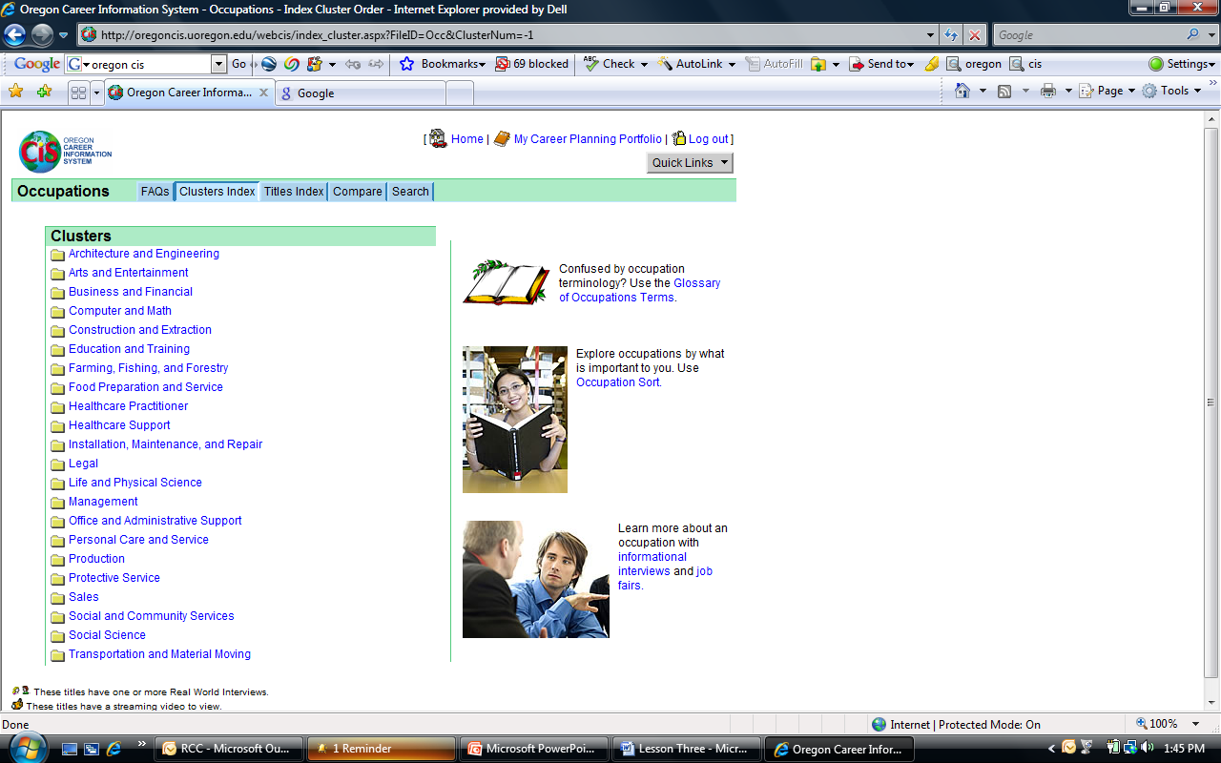
Finding Occupational Clusters in CIS
1, click
Occupations
2, click
Cluster Index

Slide 3
Internet Career Information Addresses
OLMIS: http://www.qualityinfo.org/olmisj/OlmisZine
OOH: http://www.bls.gov/oco/
CIS: http://oregoncis.uoregon.edu/

